Slide 1
Computer Graphics labs
Lab 5 - Transparency and Blending

Slide 2
Up to this point we are dealing with opaque materials

Slide 3
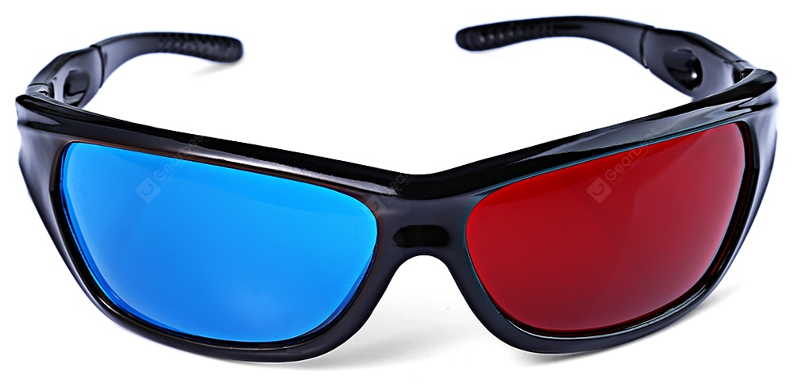
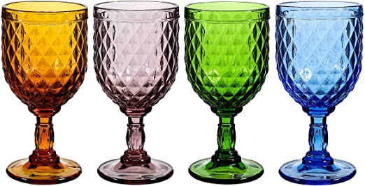
Transparent Objects

Slide 4
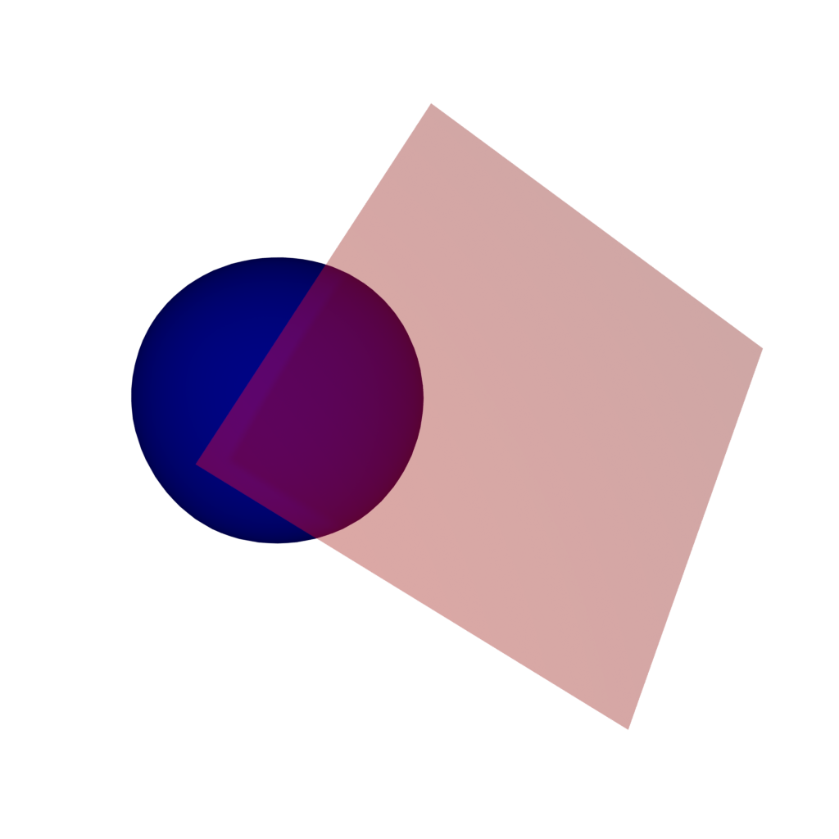
Blending
Semi-Transparent Object
Opaque Object
Transparency is like we want to see a bit of both objects.

Slide 5
eye
source
destination
Full transparent
Fully opaque
Alpha = 0
Alpha = 0.25
Alpha = 0.5
Alpha = 0.75
Alpha = 1

Slide 6
Over Operator
C = ∝_{s}C_{s} + (1 - ∝_{s})C_{D}
C = C_{D}
When ∝_{s} = 0
C = C_{s}
When ∝_{s} = 1
Linear interpolation
Notes:
Cs is the source color
Cd is the dest color

Slide 7
OpenGL gives us the ability to control
Source Factor
Equation
Destination Factor
C = ∝_{s}C_{s} + (1 - ∝_{s})C_{D}
Source
Destination

Slide 8
Destination Factor
Could be:
GL_ZERO: ZERO
GL_ONE: ONE
GL_SRC_COLOR: SOURCE COLOR
GL_ONE_MINUS_SRC_COLOR: 1 - SOURCE COLOR
GL_DST_COLOR: DESTINATION COLOR
GL_ONE_MINUS_DST_COLOR: 1 -DESTINATION COLOR
GL_SRC_ALPHA: SOURCE ALPHA
GL_ONE_MINUS_SRC_ALPHA: 1 - SOURCE ALPHA
GL_DST_ALPHA: DESTINATION ALPHA
GL_ONE_MINUS_DST_ALPHA: 1 - DESTINATION ALPHA
GL_CONSTANT_COLOR: CONSTANT
GL_ONE_MINUS_CONSTANT_COLOR: 1 - CONSTANT COLOR
GL_CONSTANT_ALPHA: CONSTANT ALPHA GL_ONE_MINUS_CONSTANT_ALPHA: 1 - CONSTANT ALPHA
Source Factor

Slide 9
Equation
Could be:
GL_FUNC_ADD: ADDITION
GL_FUNC_SUBTRACT: SUBTRACTION
GL_FUNC_REVERSE_SUBTRACT: REVERSE SUBTRACTION
GL_MIN: MIN
GL_MAX: MAX

Slide 10
The most common blending setup
glEnable(GL_BLEND);
glBlendEquation(GL_FUNC_ADD);
glBlendFunc(GL_SRC_ALPHA, GL_ONE_MINUS_SRC_ALPHA);

Slide 11
Commands:
Draw Blue Rectangle (0, 0, 1, 0.5)
Draw Red Rectangle (1, 0, 0, 0.5)
Blending Setup:
Equation: GL_FUNC_ADD
Factors: GL_SRC_ALPHA, GL_ONE_MINUS_SRC_ALPHA
Source
Destination
(0, 0, 1, 0.5)
(0, 0, 0, 1)
Notes:
Source is back buffer and dest is the front buffer

Slide 12
Commands:
Draw Blue Rectangle (0, 0, 1, 0.5)
Draw Red Rectangle (1, 0, 0, 0.5)
Blending Setup:
Equation: GL_FUNC_ADD
Factors: GL_SRC_ALPHA, GL_ONE_MINUS_SRC_ALPHA
Source
Destination
(0, 0, 0.5, 0.75)

Slide 13
Commands:
Draw Blue Rectangle (0, 0, 1, 0.5)
Draw Red Rectangle (1, 0, 0, 0.5)
Blending Setup:
Equation: GL_FUNC_ADD
Factors: GL_SRC_ALPHA, GL_ONE_MINUS_SRC_ALPHA
Source
Destination
(1, 0, 0, 0.5)

Slide 14
Commands:
Draw Blue Rectangle (0, 0, 1, 0.5)
Draw Red Rectangle (1, 0, 0, 0.5)
Blending Setup:
Equation: GL_FUNC_ADD
Factors: GL_SRC_ALPHA, GL_ONE_MINUS_SRC_ALPHA
Source
Destination
(0.5, 0, 0.25, 0.625)
(0.5, 0, 0, 0.75)

Slide 15
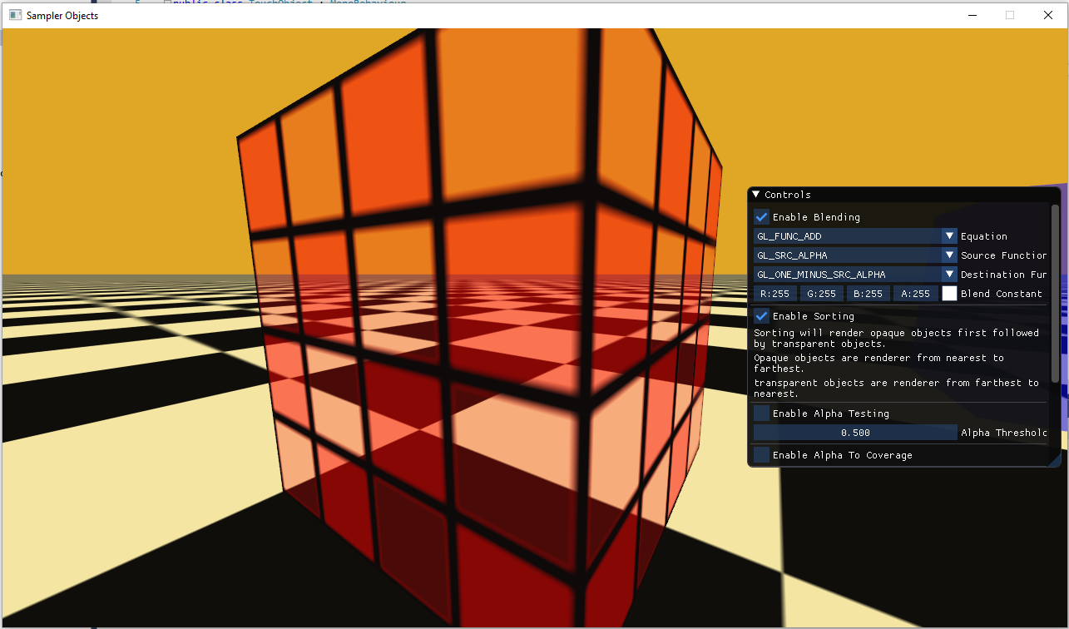
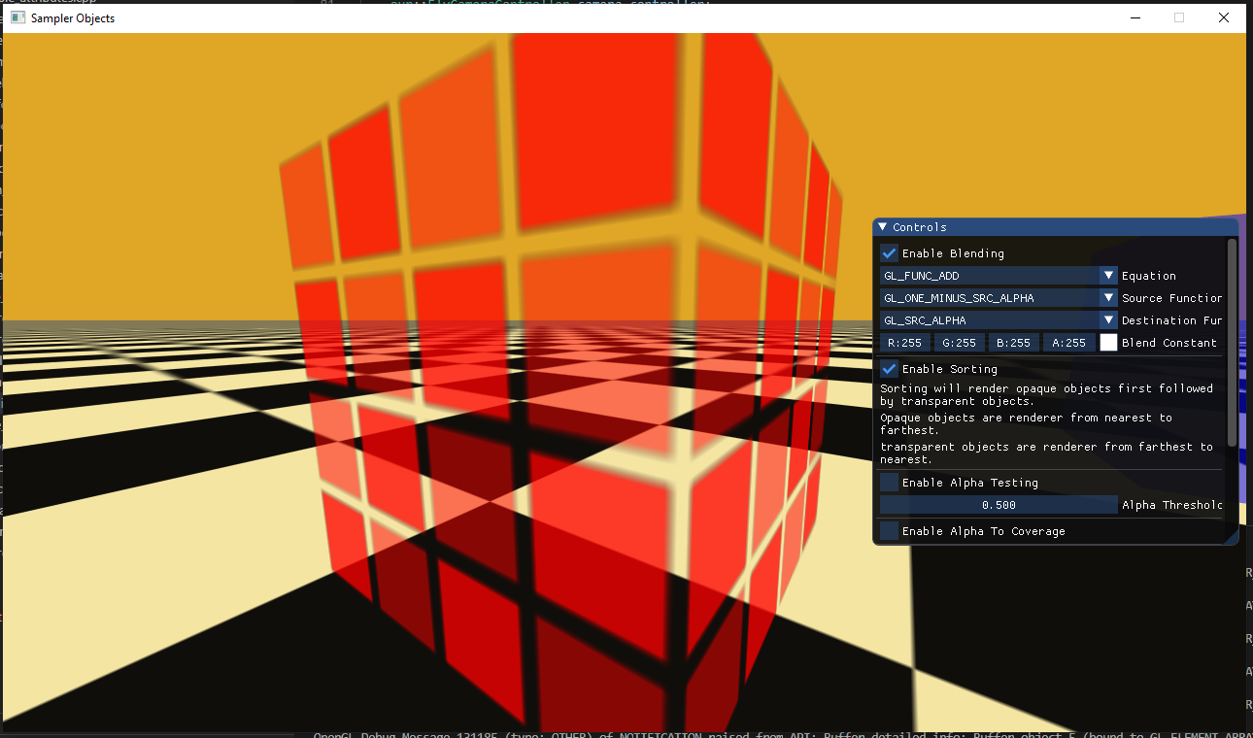
(SOURCE ALPHA) ADD (1 - SOURCE ALPHA)
(1 - SOURCE ALPHA) ADD (SOURCE ALPHA)

Slide 16
And many other combinations

Slide 17
Z-Buffer and transparency

Slide 18
Let us consider this drawing order scenario
eye
source
destination
Z-Depth
Drawn 1st
Pixel
Drawn 2nd

Slide 19
But what if
eye
source
destination
Z-Depth
Drawn 1st
Pixel
Drawn 2nd
Blocked
Notes:
The depth buffer won’t let the blue color appear because the red is nearer 3ks al slide ali fatt ali rsmt feha al blue al awel we b3den al red fa adani mix al color bs hna rsmt al 2oryb al awel fa al b3den mtrsm4 omal hnak rmst al b3de al awel fa 3ml mix alwan

Slide 20
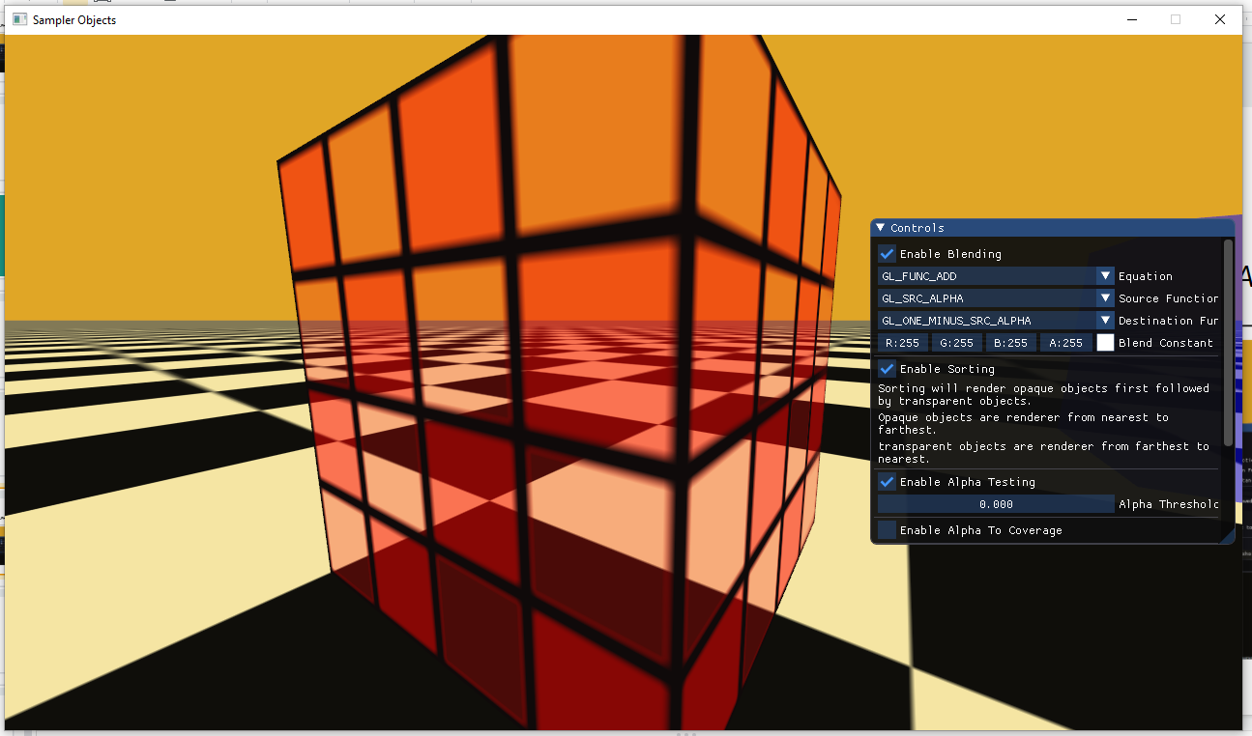
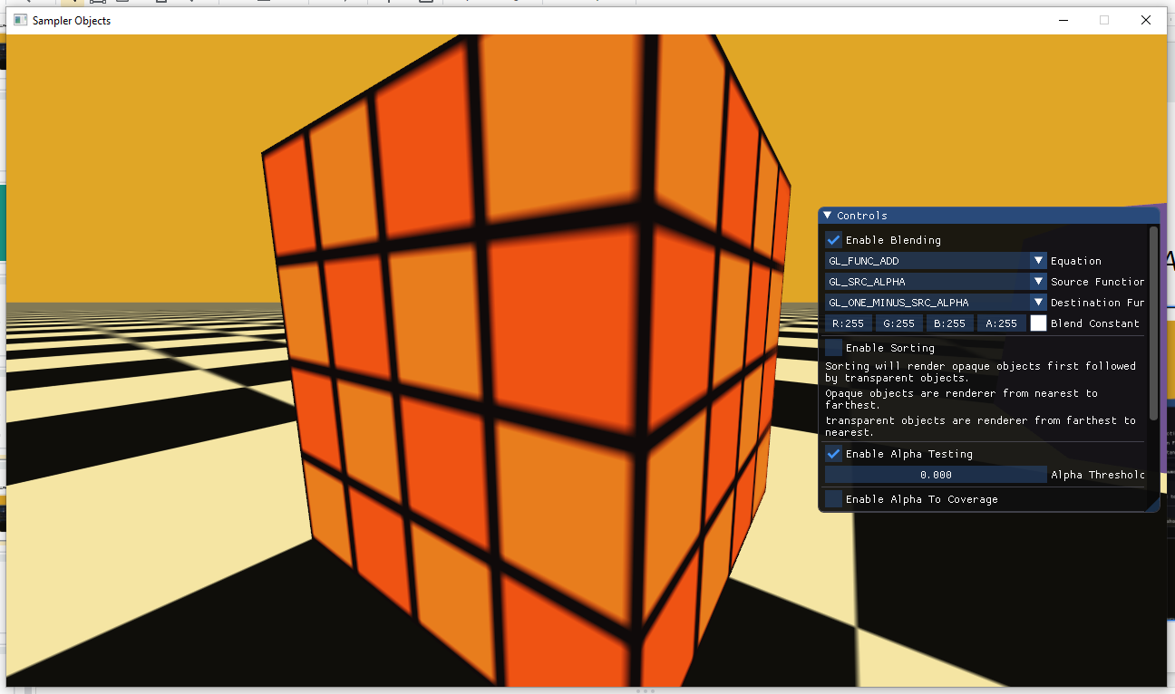
With sorting
The ground is drawn first to enable blending
Without sorting
The cube is drawn first blocking the ground
Notes:
Al sora ali 3laa al ymen rsmt al b3de al awel ya3ni akni 3mlt sort lel depth buffer we rsmt ali value bt3dt kber al awel fa lma 7tat al 2a2rb b3deha 3ml mix bs 3la al ymen 7sl al 3ks

Slide 21
Commands:
Draw Blue Rectangle (0, 0, 1, 0.5) at Depth 0.9
Draw Red Rectangle (1, 0, 0, 0.5) at Depth 0.2
Draw Green Rectangle (0, 1, 0, 0.5) at Depth 0.5
1.0
1.0
1.0
1.0
1.0
1.0
1.0
1.0
1.0
1.0
1.0
1.0
1.0
1.0
1.0
1.0
1.0
1.0
1.0
1.0
1.0
1.0
1.0
1.0
1.0
1.0
1.0
1.0
1.0
1.0
1.0
1.0
1.0
1.0
1.0
1.0
1.0
1.0
1.0
1.0
1.0
1.0
1.0
1.0
1.0
1.0
1.0
1.0
Depth Buffer
Color Buffer

Slide 22
Commands:
Draw Blue Rectangle (0, 0, 1, 0.5) at Depth 0.9
Draw Red Rectangle (1, 0, 0, 0.5) at Depth 0.2
Draw Green Rectangle (0, 1, 0, 0.5) at Depth 0.5
1.0
1.0
1.0
1.0
1.0
1.0
1.0
1.0
1.0
1.0
1.0
0.9
0.9
0.9
0.9
1.0
1.0
1.0
1.0
0.9
0.9
0.9
0.9
1.0
1.0
1.0
1.0
0.9
0.9
0.9
0.9
1.0
1.0
1.0
1.0
1.0
1.0
1.0
1.0
1.0
1.0
1.0
1.0
1.0
1.0
1.0
1.0
1.0
Depth Buffer
Color Buffer

Slide 23
Commands:
Draw Blue Rectangle (0, 0, 1, 0.5) at Depth 0.9
Draw Red Rectangle (1, 0, 0, 0.5) at Depth 0.2
Draw Green Rectangle (0, 1, 0, 0.5) at Depth 0.5
1.0
1.0
1.0
1.0
1.0
1.0
1.0
1.0
1.0
1.0
1.0
0.9
0.9
0.9
0.9
1.0
1.0
1.0
1.0
0.9
0.9
0.9
0.9
1.0
1.0
0.2
0.2
0.2
0.2
0.9
0.9
1.0
1.0
0.2
0.2
0.2
0.2
1.0
1.0
1.0
1.0
0.2
0.2
0.2
0.2
1.0
1.0
1.0
Depth Buffer
Color Buffer

Slide 24
Commands:
Draw Blue Rectangle (0, 0, 1, 0.5) at Depth 0.9
Draw Red Rectangle (1, 0, 0, 0.5) at Depth 0.2
Draw Green Rectangle (0, 1, 0, 0.5) at Depth 0.5
1.0
1.0
1.0
1.0
1.0
1.0
1.0
1.0
1.0
1.0
1.0
0.9
0.9
0.9
0.9
1.0
1.0
1.0
0.5
0.5
0.5
0.5
0.9
1.0
1.0
0.2
0.2
0.2
0.2
0.5
0.9
1.0
1.0
0.2
0.2
0.2
0.2
0.5
1.0
1.0
1.0
0.2
0.2
0.2
0.2
1.0
1.0
1.0
Depth Buffer
Color Buffer

Slide 25
Commands: (NO DEPTH TESTING)
Draw Blue Rectangle (0, 0, 1, 0.5) at Depth 0.9
Draw Red Rectangle (1, 0, 0, 0.5) at Depth 0.2
Draw Green Rectangle (0, 1, 0, 0.5) at Depth 0.5
Incorrect Result
(Order Matters)
1.0
1.0
1.0
1.0
1.0
1.0
1.0
1.0
1.0
1.0
1.0
1.0
1.0
1.0
1.0
1.0
1.0
1.0
1.0
1.0
1.0
1.0
1.0
1.0
1.0
1.0
1.0
1.0
1.0
1.0
1.0
1.0
1.0
1.0
1.0
1.0
1.0
1.0
1.0
1.0
1.0
1.0
1.0
1.0
1.0
1.0
1.0
1.0
Depth Buffer
Color Buffer

Slide 26
Commands (Sorted):
Draw Blue Rectangle (0, 0, 1, 0.5) at Depth 0.9
Draw Green Rectangle (0, 1, 0, 0.5) at Depth 0.5
Draw Red Rectangle (1, 0, 0, 0.5) at Depth 0.2
Correct Result
1.0
1.0
1.0
1.0
1.0
1.0
1.0
1.0
1.0
1.0
1.0
0.9
0.9
0.9
0.9
1.0
1.0
1.0
0.5
0.5
0.5
0.5
0.9
1.0
1.0
0.2
0.2
0.2
0.2
0.5
0.9
1.0
1.0
0.2
0.2
0.2
0.2
0.5
1.0
1.0
1.0
0.2
0.2
0.2
0.2
1.0
1.0
1.0
Depth Buffer
Color Buffer

Slide 27
So now we are back to the Painter’s algorithm

Slide 28
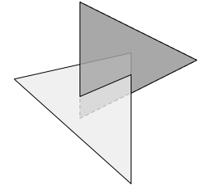
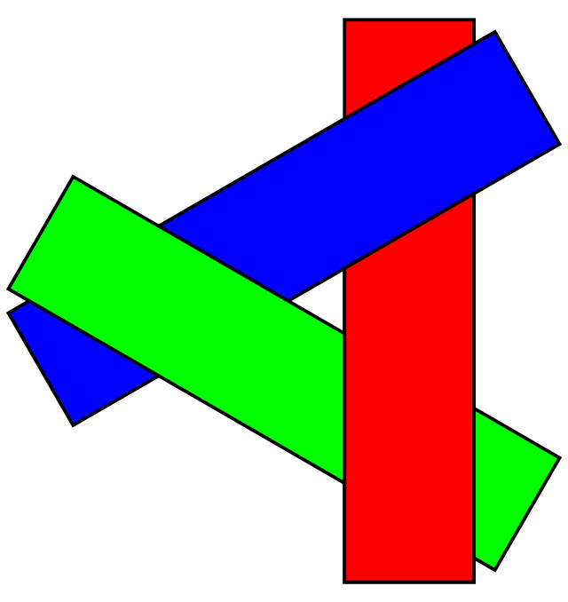
Painter’s Algorithm
Do You Remember?
Sort from Farthest to Nearest.
PROS:
Memory Efficient.
Still popular for transparent geometry till today.
CONS:
Can be computationally expensive.
Fails for intersecting and cyclically-overlapping geometry.
Intersecting
Cyclical Overlapping

Slide 29
Common Handling of Transparency in Games
Draw Opaque Objects first and:
Use Depth Buffer to resolve depth among each other.
Prefer to draw to nearest to farthest to decrease overdraw. (Optional)
Then draw Transparent Objects and:
Use Depth Buffer to resolve depth with the Opaque Objects.
Strictly draw from farthest to nearest.

Slide 30
Other solutions
Use a blending setup that doesn’t care about order (such as Multiplicative Blending) and disable depth testing. But it can only represent certain types of transparent objects.
Use depth peeling. [Expensive]
Use Order Independent Transparency via per-pixel linked-list sorting. [Expensive]
Use Alpha Testing. But fragments can either be fully opaque or fully transparent.
Use Screen-Door Transparency (Dithering). But it looks bad at low resolution and needs special handling for multiple layers of transparent objects.
Use Alpha to Coverage. But it only works when MSAA is enabled, can cause banding and needs special handling for multiple layers of transparent objects.
Stochastic Transparency. But it requires either MSAA or temporal AA.

Slide 31
Alpha testing

Slide 32
Another way to allow transparency
Is to discard pixels

Slide 33
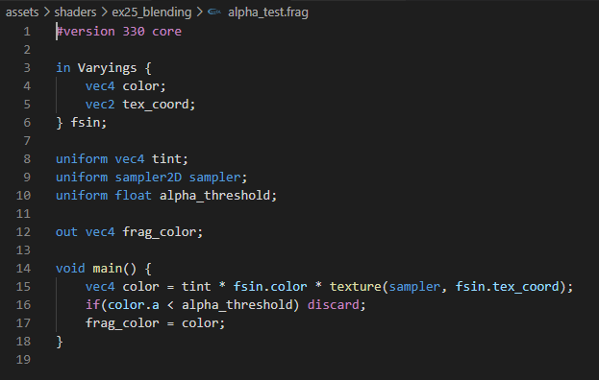
Discard
Discard pixels prevents them from being drawn.
By increasing the value of the threshold, the amount of drawn pixels decreases.

Slide 34
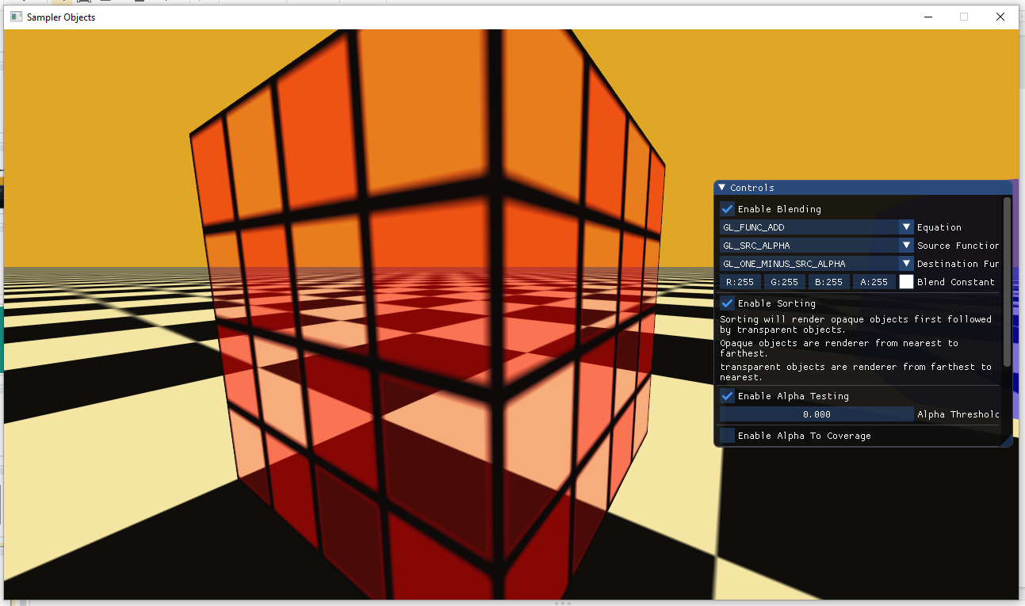
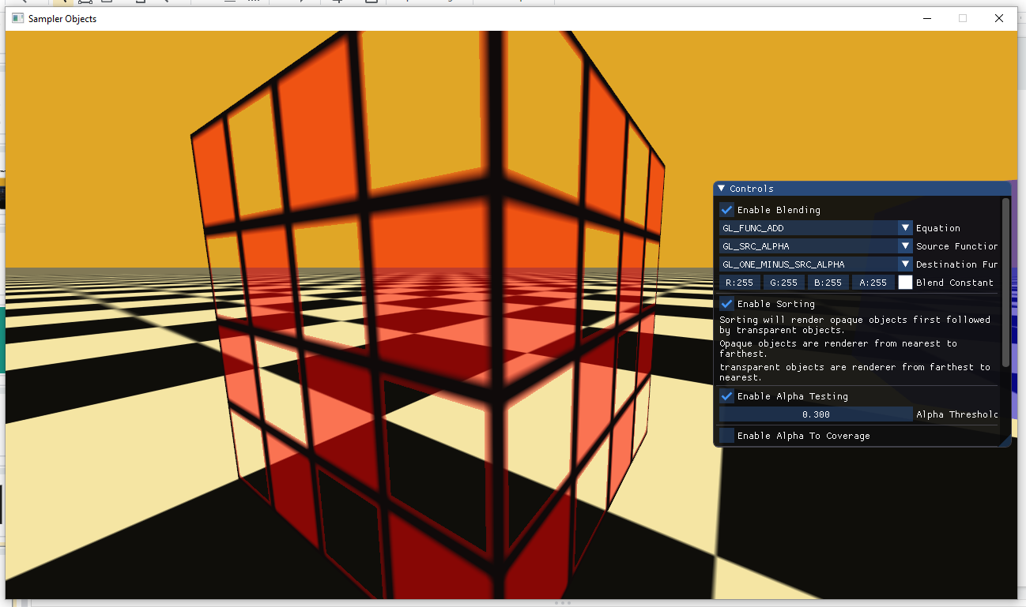
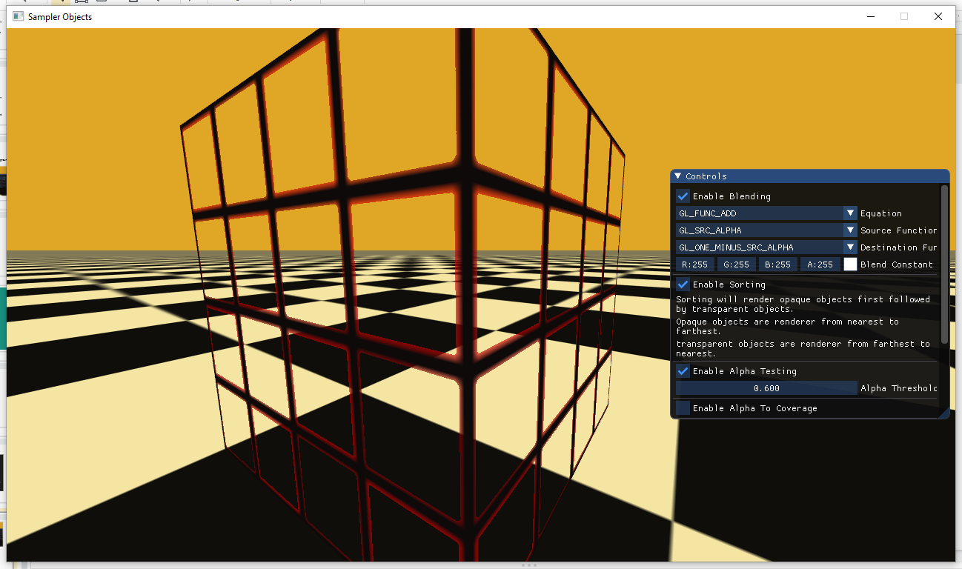
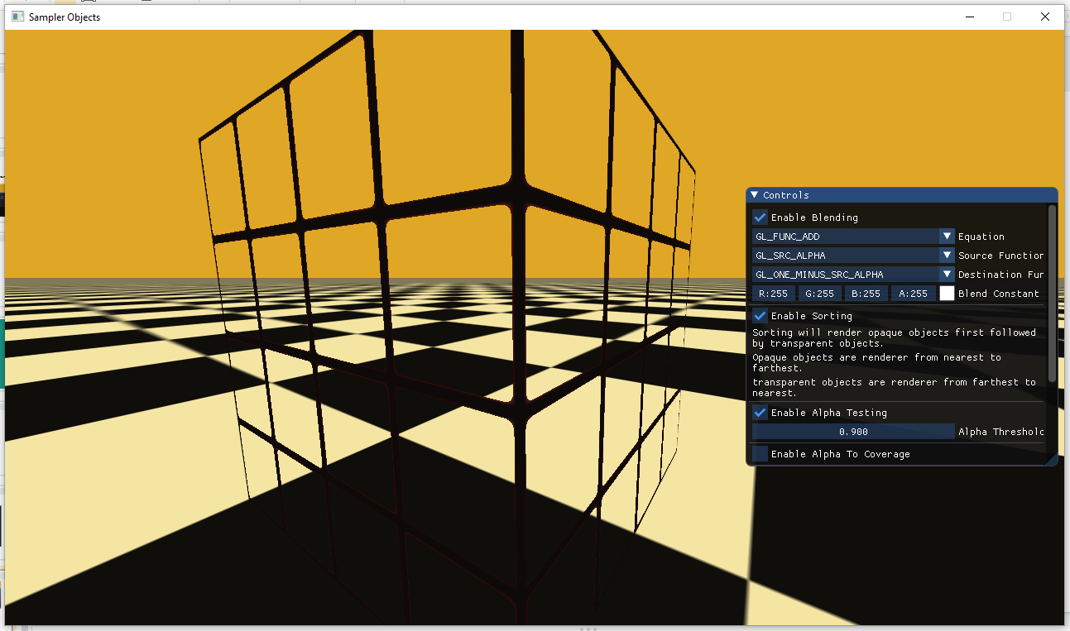
Threshold = 0
Threshold = 0.3
Threshold = 0.6
Threshold = 0.95

Slide 35
Commands:
Draw Alpha-Tested Checkerboard Rectangle (0, 0, 1, 1) & (0, 0, 1, 0) at Depth 0.2
Draw Red Rectangle (1, 0, 0, 0.5) at Depth 0.9
1.0
1.0
1.0
1.0
1.0
1.0
1.0
1.0
1.0
1.0
1.0
1.0
1.0
1.0
1.0
1.0
1.0
1.0
1.0
1.0
1.0
1.0
1.0
1.0
1.0
1.0
1.0
1.0
1.0
1.0
1.0
1.0
1.0
1.0
1.0
1.0
1.0
1.0
1.0
1.0
1.0
1.0
1.0
1.0
1.0
1.0
1.0
1.0
Depth Buffer
Color Buffer

Slide 36
Commands:
Draw Alpha-Tested Checkerboard Rectangle (0, 0, 1, 1) & (0, 0, 1, 0) at Depth 0.2
Draw Red Rectangle (1, 0, 0, 0.5) at Depth 0.5
1.0
1.0
1.0
1.0
1.0
1.0
1.0
1.0
1.0
0.2
1.0
0.2
1.0
0.2
1.0
1.0
1.0
1.0
0.2
1.0
0.2
1.0
0.2
1.0
1.0
0.2
1.0
0.2
1.0
0.2
1.0
1.0
1.0
1.0
0.2
1.0
0.2
1.0
0.2
1.0
1.0
1.0
1.0
1.0
1.0
1.0
1.0
1.0
Depth Buffer
Color Buffer

Slide 37
Commands:
Draw Alpha-Tested Checkerboard Rectangle (0, 0, 1, 1) & (0, 0, 1, 0) at Depth 0.2
Draw Red Rectangle (1, 0, 0, 0.5) at Depth 0.5
1.0
1.0
0.5
0.5
0.5
0.5
0.5
0.5
1.0
0.2
0.5
0.2
0.5
0.2
0.5
0.5
1.0
1.0
0.2
0.5
0.2
0.5
0.2
0.5
1.0
0.2
0.5
0.2
0.5
0.2
0.5
0.5
1.0
1.0
0.2
1.0
0.2
1.0
0.2
1.0
1.0
1.0
1.0
1.0
1.0
1.0
1.0
1.0
Depth Buffer
Color Buffer

Slide 38
While transparency is simple as a concept and common in most applications, it is still a technical challenge till nowadays.

Slide 39
Thank you

